Slide 1
Microbes and Cancer: From Sequence to Consequence
Abraham Gihawi
A.Gihawi@uea.ac.uk
29th Sep 2023

Slide 2
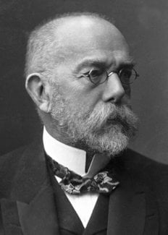
Establishing ‘Consequence’
Koch’s postulates (1884):
Gold standard framework for causality:
Organism must be in every disease case, not in healthy controls
Isolated from disease case & grown in pure culture
Pure culture must cause disease when re-introduced
Re-isolate pathogen from experimentally infected individuals
Fig: https://www.nobelprize.org/prizes/medicine/1905/koch/biographical/

Slide 3

Challenges
No animal models? (Koch & Cholera 1884)
Can’t re-introduce pathogens to humans
‘Hit and run’ hypothesis (esp. cancer)
Disease can take years to form (microbes in healthy individuals)
Polymicrobial disease - Corynebacterium diphtheriae - bacteriophage
Microbes that can’t be isolated?
Co-culturing can also be challenging
Not every infection causes disease
Another consideration: Genes cause disease, not taxonomy
i.e. pks⁺ Enterococcus & colorectal cancer
Fortunately, we have sequencing… So it’s easier, right?
Grimes, D. Jay. Microbe-American Society for Microbiology 1.5 (2006): 223.
Fig: https://www.freepik.com/free-photo/frustrated-scientist-man_1184261.htm
Notes:
Polymicrobial – anaerobes in periodontal disease
Genes causing disease vs taxonomy – example of colibactin and other enterococcus

Slide 4
Rous Sarcoma Virus
Francis Peyton Rous - 1911
First evidence of infection & cancer
Largely ignored until Howard Temin 1975
Fig: Weinberg RA. The Biology of Cancer. 2014
Notes:
Followed death of Koch in 1910

Slide 5
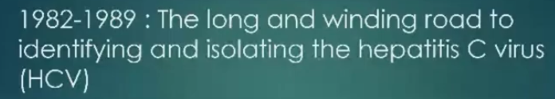


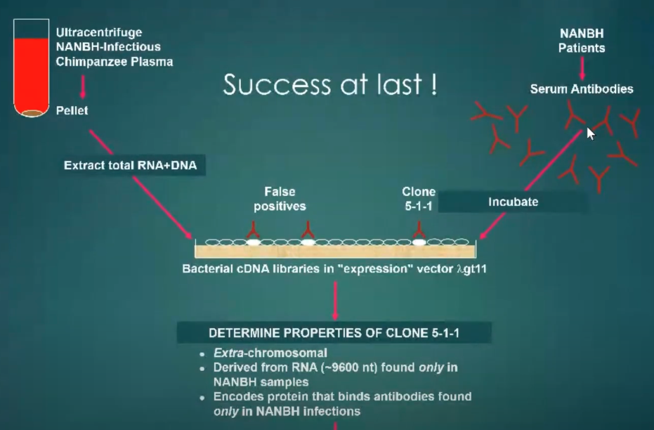
Hepatitis C Virus - Michael Haughton
UEA alumni
First described as ‘non-A non-B’ hepatitis
‘Bare tool-box in 1982’
No PCR, no cell culture system, no sequencing
Just some infected human/chimp materials
Many investigations did not work, one did
Many experiments to characterise afterwards
Nobel prize 2020
Other nobel laureates
Robert Koch – 1905
Francis Peyton Rous – RSV - 1966
Howard Temin - RSV – 1975
Marshall and Warren – H. pylori – 2005
Hausen – HPV - 2008
Notes:
ALT – alanine aminotransferase

Slide 6
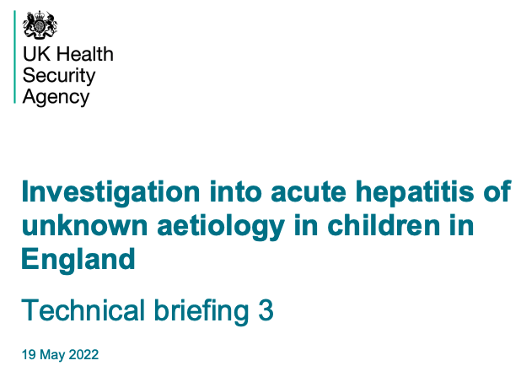
Modern examples – sequence to consequence
We are getting quicker…
‘Non-A,B,C,D,E’ hepatitis in the young
197 cases 1st Jan → May 2022
Caused by adeno-associated virus 2
From metagenomic sequencing (bending Koch’s #1)
… But identifying didn’t change clinical management
SARS-CoV-2
‘Viral pneumonia’ of unknown cause
31 Dec 2019 - 27 cases in Wuhan
7th Jan – China isolated strain
9th Jan – First death
12th Jan – Assembly released
Quickest example of consequence → sequence → translational impact (vaccine)
genomic surveillance / policy impacts
Quick discovery/translation needs clean, trustworthy data
Notes:
Might not have been the case with a multi-pathogen infection
These examples also have hundreds/thousands of people working on them

Slide 7
Metagenomics in Discovery
Great when you don’t know what you’re looking for
Permits hypothesis free research
Survey all tree of life
Needs the right samples/type
Limited role in in identifying community transmission so far (UKHSA)
Potential to expand metagenomic surveillance (expensive)
Role for clinicians ordering metagenomics
Needs value for money &infrastructure
Meera Chand (UKHSA) – “The most important thing we can do now: Provide the methodology to make this easy, my guess – 5 years”
We sequence lots… tonnes of data
Machine learning/AI should make it easy to find associations, no?
Notes:
Meera Chand – a National covid-19 incident director at UKHSA / Microbiologist
Tonnes of data. -and archive data for outbreak comparisons

Slide 8
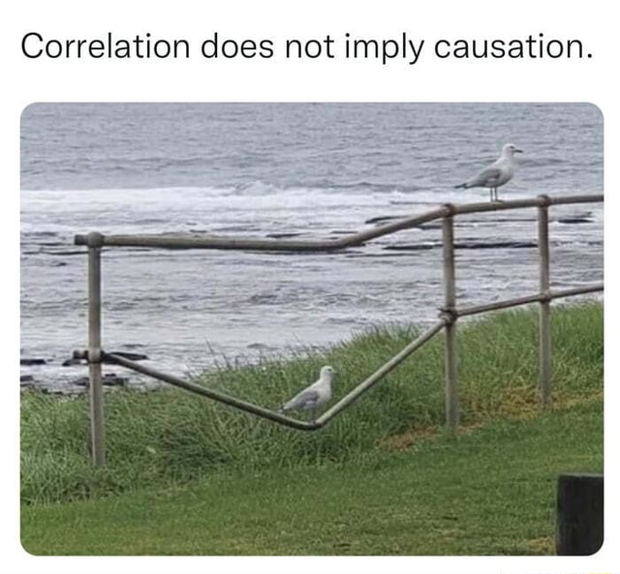
Establishing Causality
Establishing causality can be simple
But is often complex
Especially in cancer
Often a process:
Years
Multi-disciplinary
Benefits from clean data
Fig: https://ifunny.co/picture/correlation-does-not-imply-causation-zzb7RS6H9

Slide 9
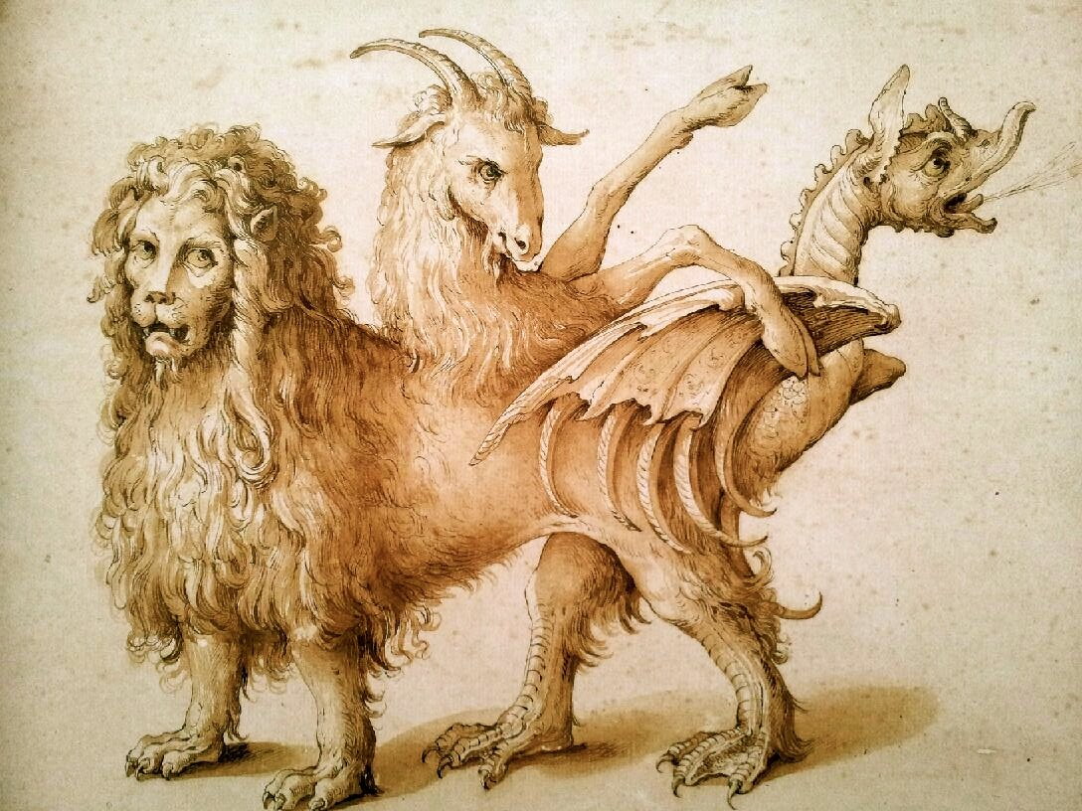
Clean Data
Contamination sources:
exogenous
well-to-well
‘kitome’
contaminated reference genomes
Chimeras:
5-6% genomes in GenBank RefSeq
15–30% “high-quality” metagenome-assembled genomes
Accurate curated metadata (may need cleaning yourself)
Accurate taxonomic classification
Solutions
Well-designed experiments
Track well-to-well (ideal)
Kitome – use lists, neg controls, some use in dilutions of same sample
Use ‘clean(er)’ genomes – don’t believe anything online
GTDB-tk & others (emerging)
Orakov et al. Genome biology, 2021
Fig: https://www.ncbcenter.org/messages-from-presidents/chimeras

Slide 10
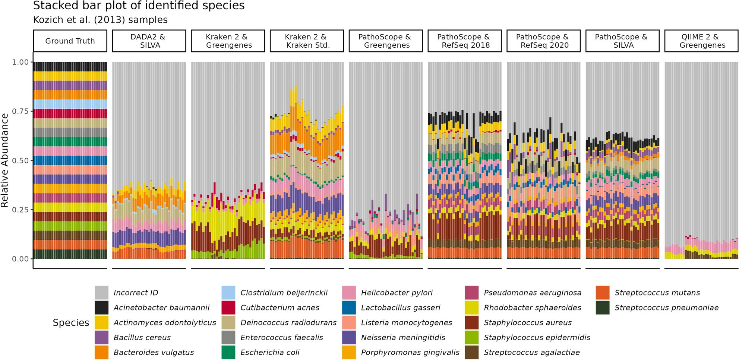
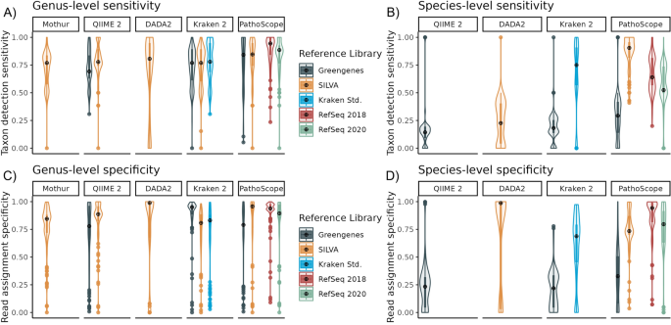
Accurate Taxonomic Classification
Taxonomic classification isn’t as good as you think it is
Software papers will portray that their tool is flawless
Plots on benchmarking 16S approaches
Published 23 Aug 2023
Genus level is a bit better
Presence-Absence likely less biased
Also, more useful clinically
Figs: Odom et al. Scientific reports (2023)

Slide 11
Case Studies

Slide 12

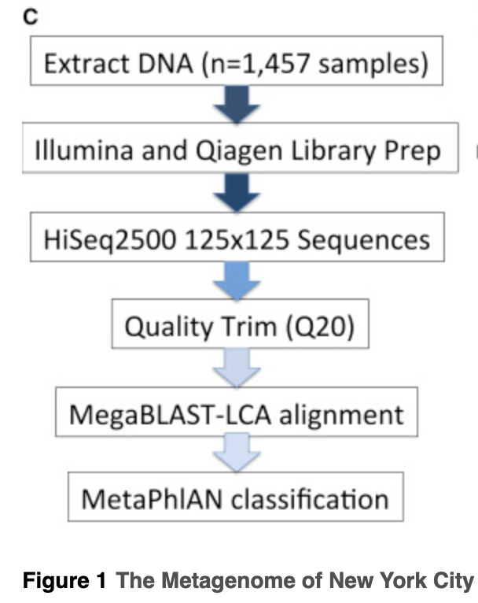
Case 1 – NY Subway-ome
Results:
Pseudomonas stutzeri
Stenotrophomonas maltophilia
Enterobacter cloacae
Acinetobacter radioresistans
Acinetobacter nosocomialis
Lysinibacillus sphaericus
Enterococcus casseliflavus
Brevundimonas diminuta
Acinetobacter lwoffii
Yersinia pestis
Bacillus anthracis
Notice anything about the results?

Slide 13
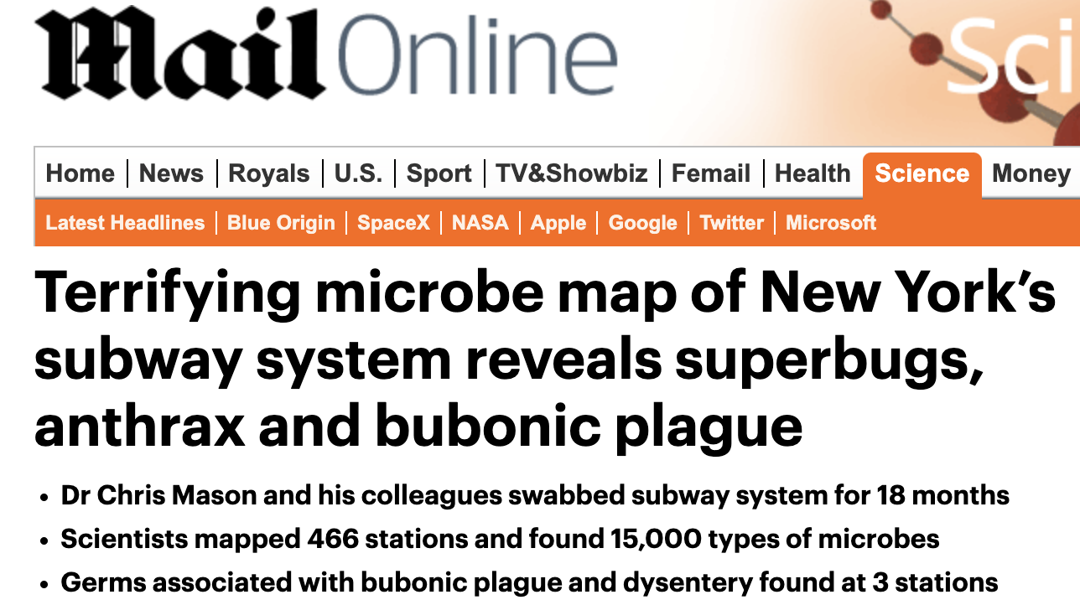




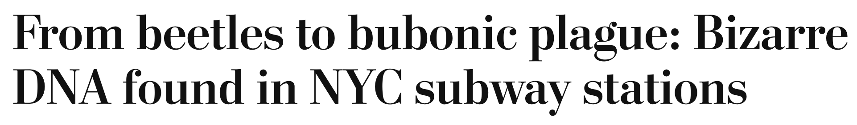


Sensational

Slide 14

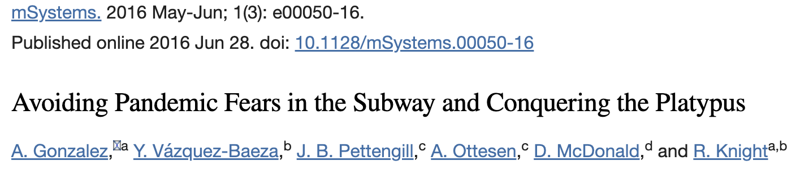
Refutations
Refuted by Hsu et al. 1.5 years later
Commented on by Gonzalez et al.
“Hsu et al. (2) demonstrated that these results were illusory.”
“These pathogens were not part of the normal subway microbiome. They drew the more plausible conclusion that the surfaces were dominated by inputs of normal human skin bacteria”
Gonzalez et al. mSystems 2016

Slide 15

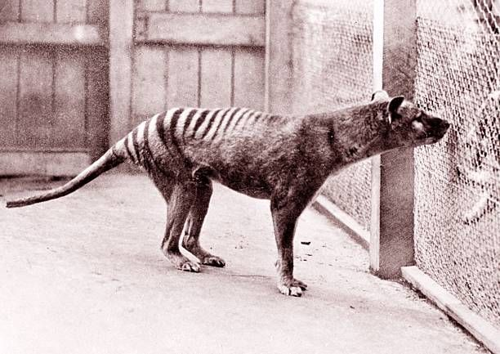
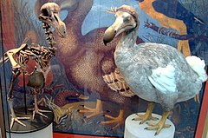
Conquering the Platypus
Noticed odd classifications coming from MG-RAST
Looking for Salmonella on food crops
MG-RAST reported:
Salmonella,
Gallus gallus (red jungle fowl),
Ornithorhynchus anatinus
They looked at all 26k MG-RAST samples:
>17 million platypus hits
>1300 hits for Thylacinus
11 hits for Raphus
“Incorrect but pervasive taxonomic classifications can lead to conclusions that lack prima facie validity”
Someone cares about accurate taxonomic classifications!
Gonzalez et al. mSystems 2016
Figs: Bino et al. Journal of Mammalogy (2019), gettyimages.co.uk/photos/thylacine, wikipedia.org/wiki/Dodo

Slide 16
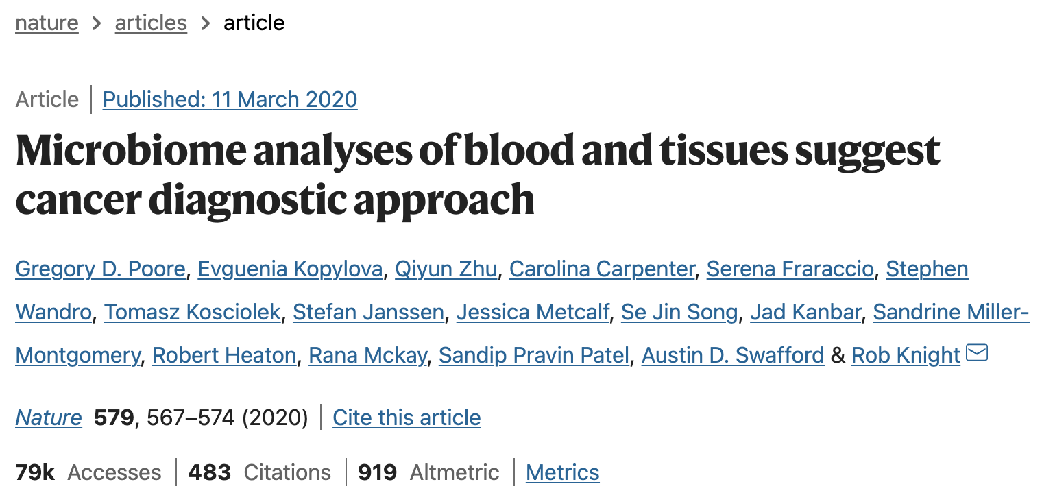
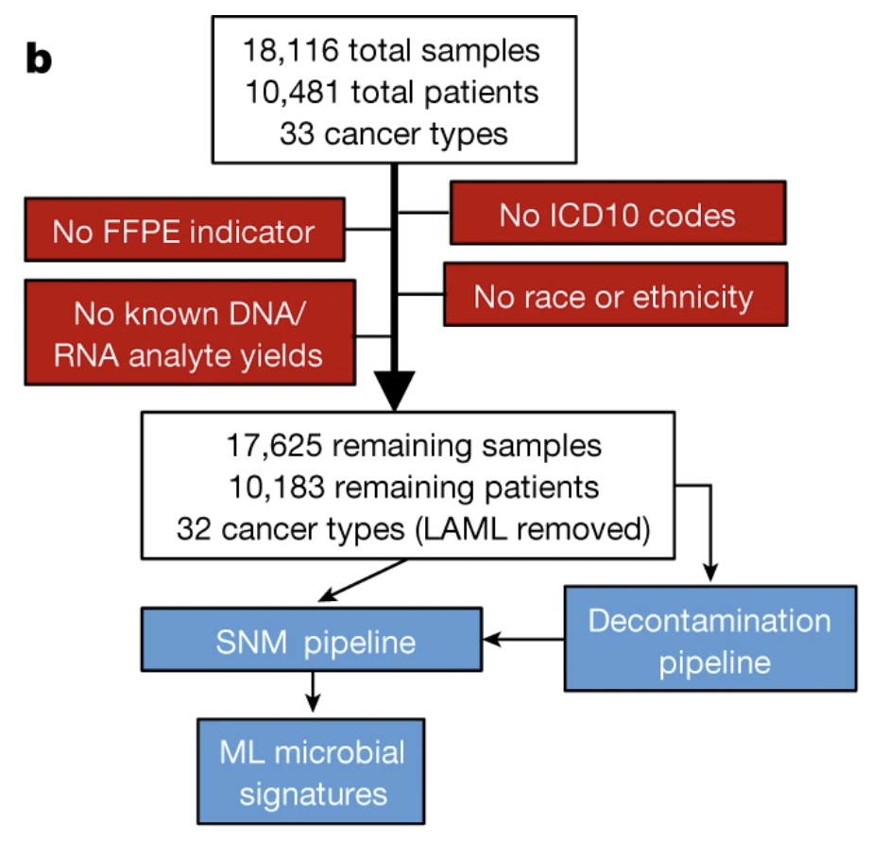
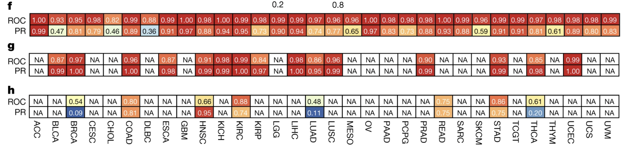
The Cancer ‘Microbiome’

Slide 17
Let’s Investigate

Slide 18
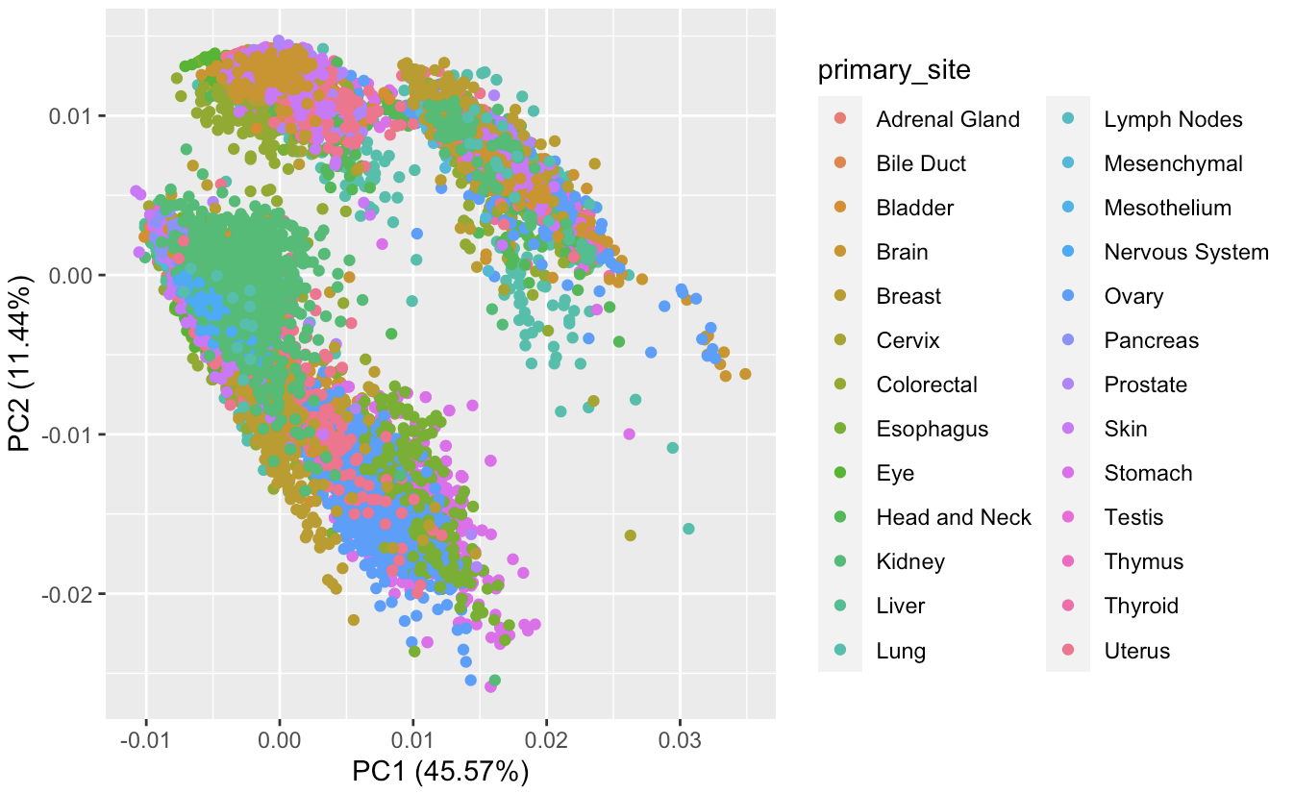
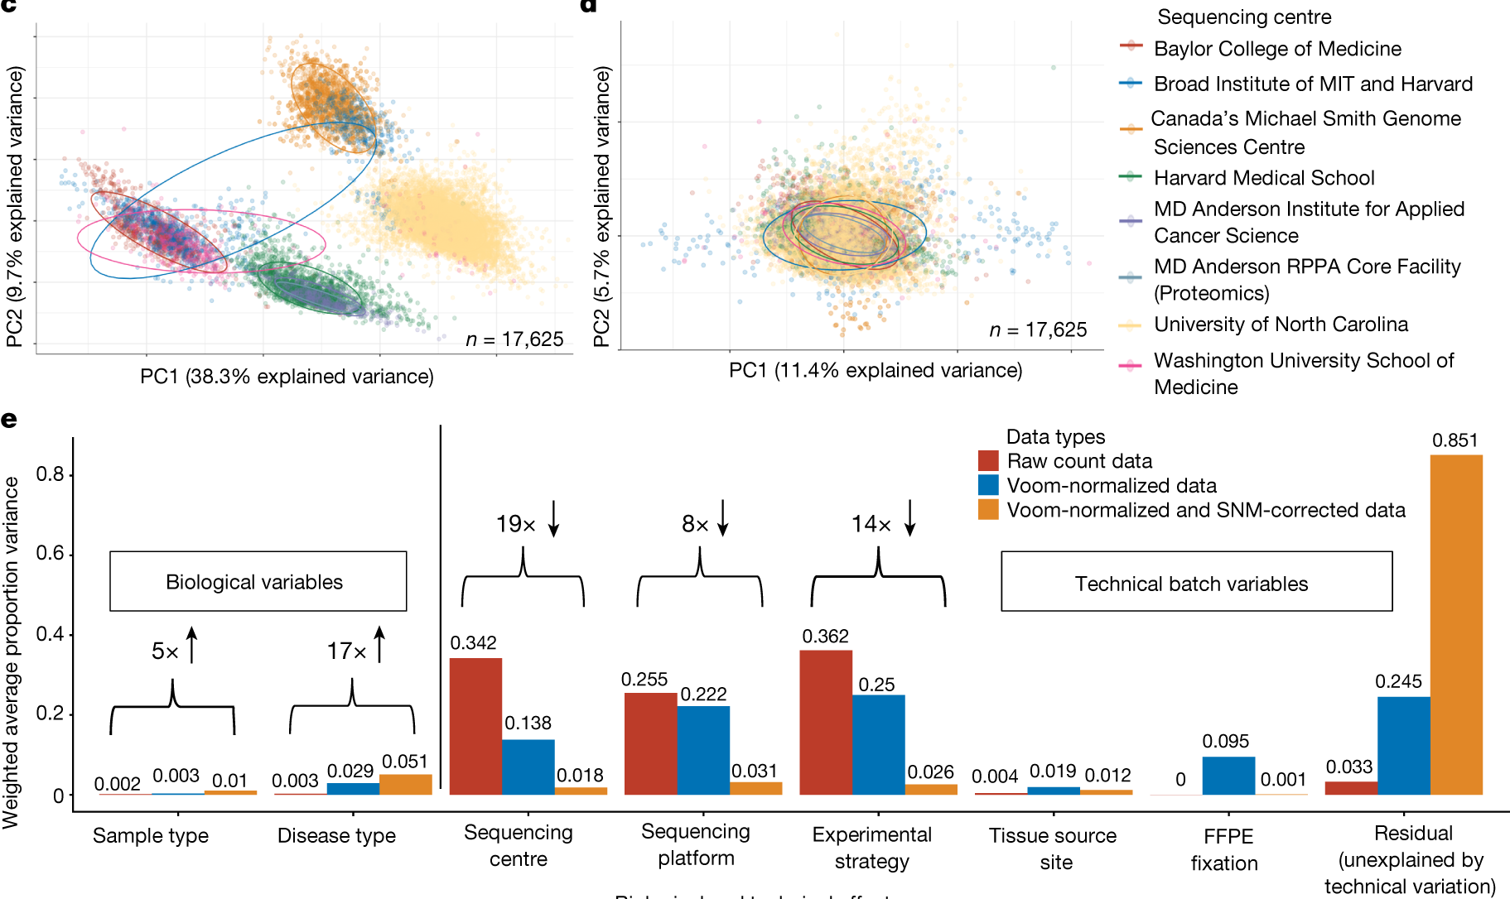
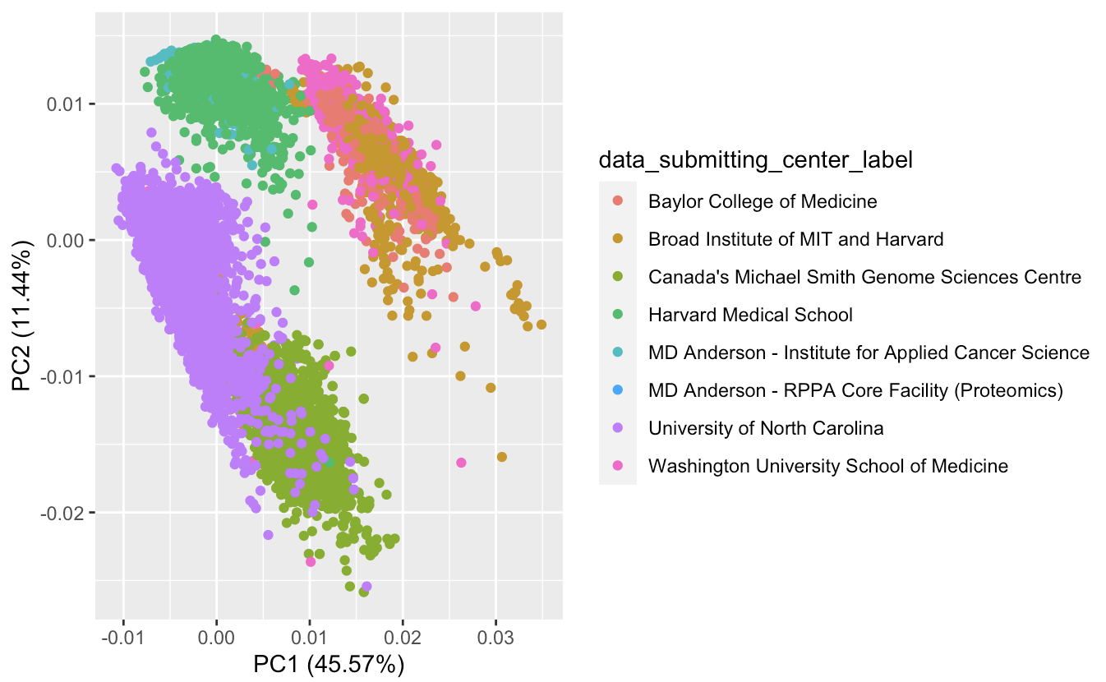
Structure by Disease Type in Raw Data?

Slide 19
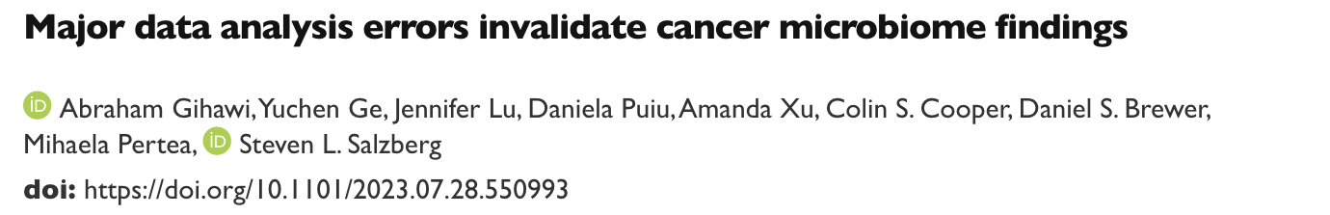
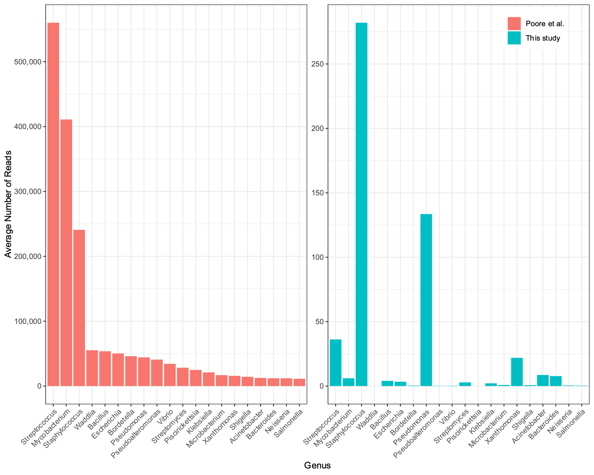
Human Reads
Realigned Poore unmapped reads to CHM13
Avg num additional human reads/sample:
1.39 million (BLCA)
1.55 million (HNSC)
3.3 million (BRCA)
No ‘human’ in classification database
Contaminated ref genomes picked up human reads
BLCA reanalysis →:
Streptococcus 16,000x lower reads
Mycobacterium 67,000x lower reads
Staphylococcus 854x lower reads
0.02% BLCA measurements within 50% of re-estimate

Slide 20
Misclassification in one sample
Streptococcus (327,985 reads) and Waddlia (20,673 reads)
Actually: 1 read and 0 reads after re-analysis
Got all 12 million unmapped reads, matched to Kraken databases:
Containing all 10,270 Streptococcus genomes (as of 2016 inc. contaminated) + all 4 Waddlia genomes
Kraken found 1.4 million Streptococcus reads, 200k Waddlia
Extracted those reads, 98.1% and 98.9% aligned to CHM13
All assigned reads were therefore actually human
Went back and reclassified with a kraken database including human:
11k Streptococcus reads, 174 Waddlia reads
Therefore: including human genome in classification databases is critical

Slide 21
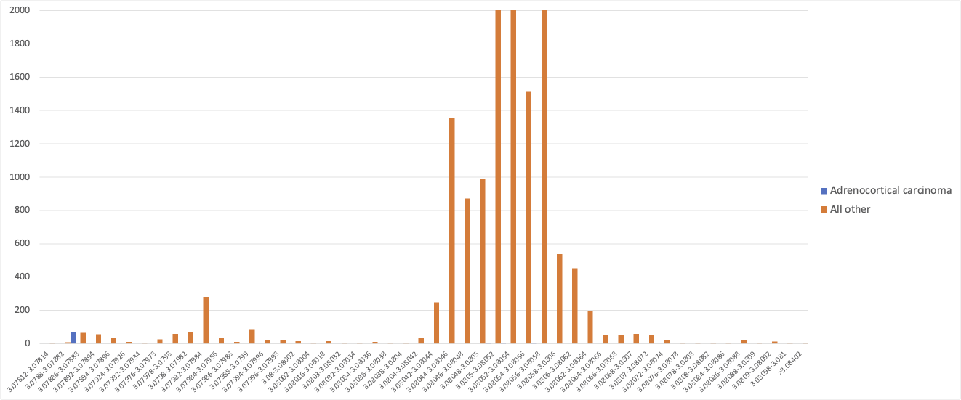
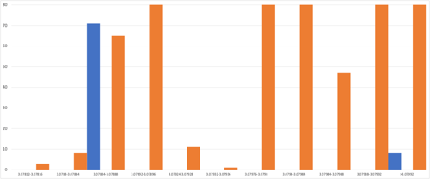
Normalization created distinct signatures of each cancer
Revisiting hepandensovirus:
17,624 samples had zero reads
One sample had two reads
All negative in ACC
71/79 samples were assigned the value 3.078874655

Slide 22
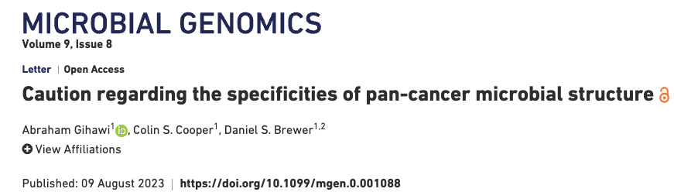
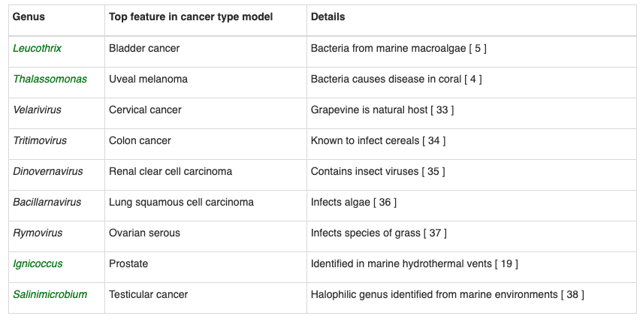
Extremophile Taxa
Extremophile taxa
Don’t make sense in the context of human disease
Some with really low numbers of reads
Machine learning deems them ‘important’ in predicting cancer type
The closest host to human for any of these taxa was the gingival sulcus of a 38-year-old lactating female dolphin
Don’t purely trust statistics

Slide 23
Normalization created distinct signatures of each cancer
Got a matrix that was all zero in the raw data
Replaced values with the normalised data
Machine learning models still perform near perfectly

Slide 24

Conclusions
Koch’s postulates are evolving but good framework for identifying consequence
Process can take years
Hypothesis generation is an important step
Need clean data (a rare commodity)
Bioinformatics errors can be incredibly sneaky
Everyone is capable of not noticing errors
Don’t trust statistics alone
Include representation of the host in your classification databases
Fig: https://twitter.com/happydolphin4u
Notes:
Clean data – you will likely need to clean and curate it yourself

